Slide 1


Slide 2
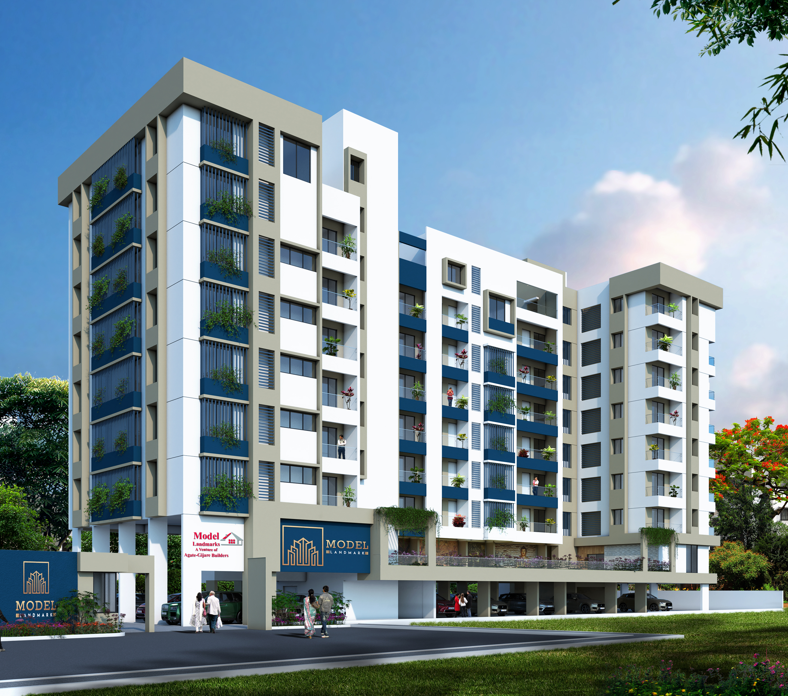


Slide 3
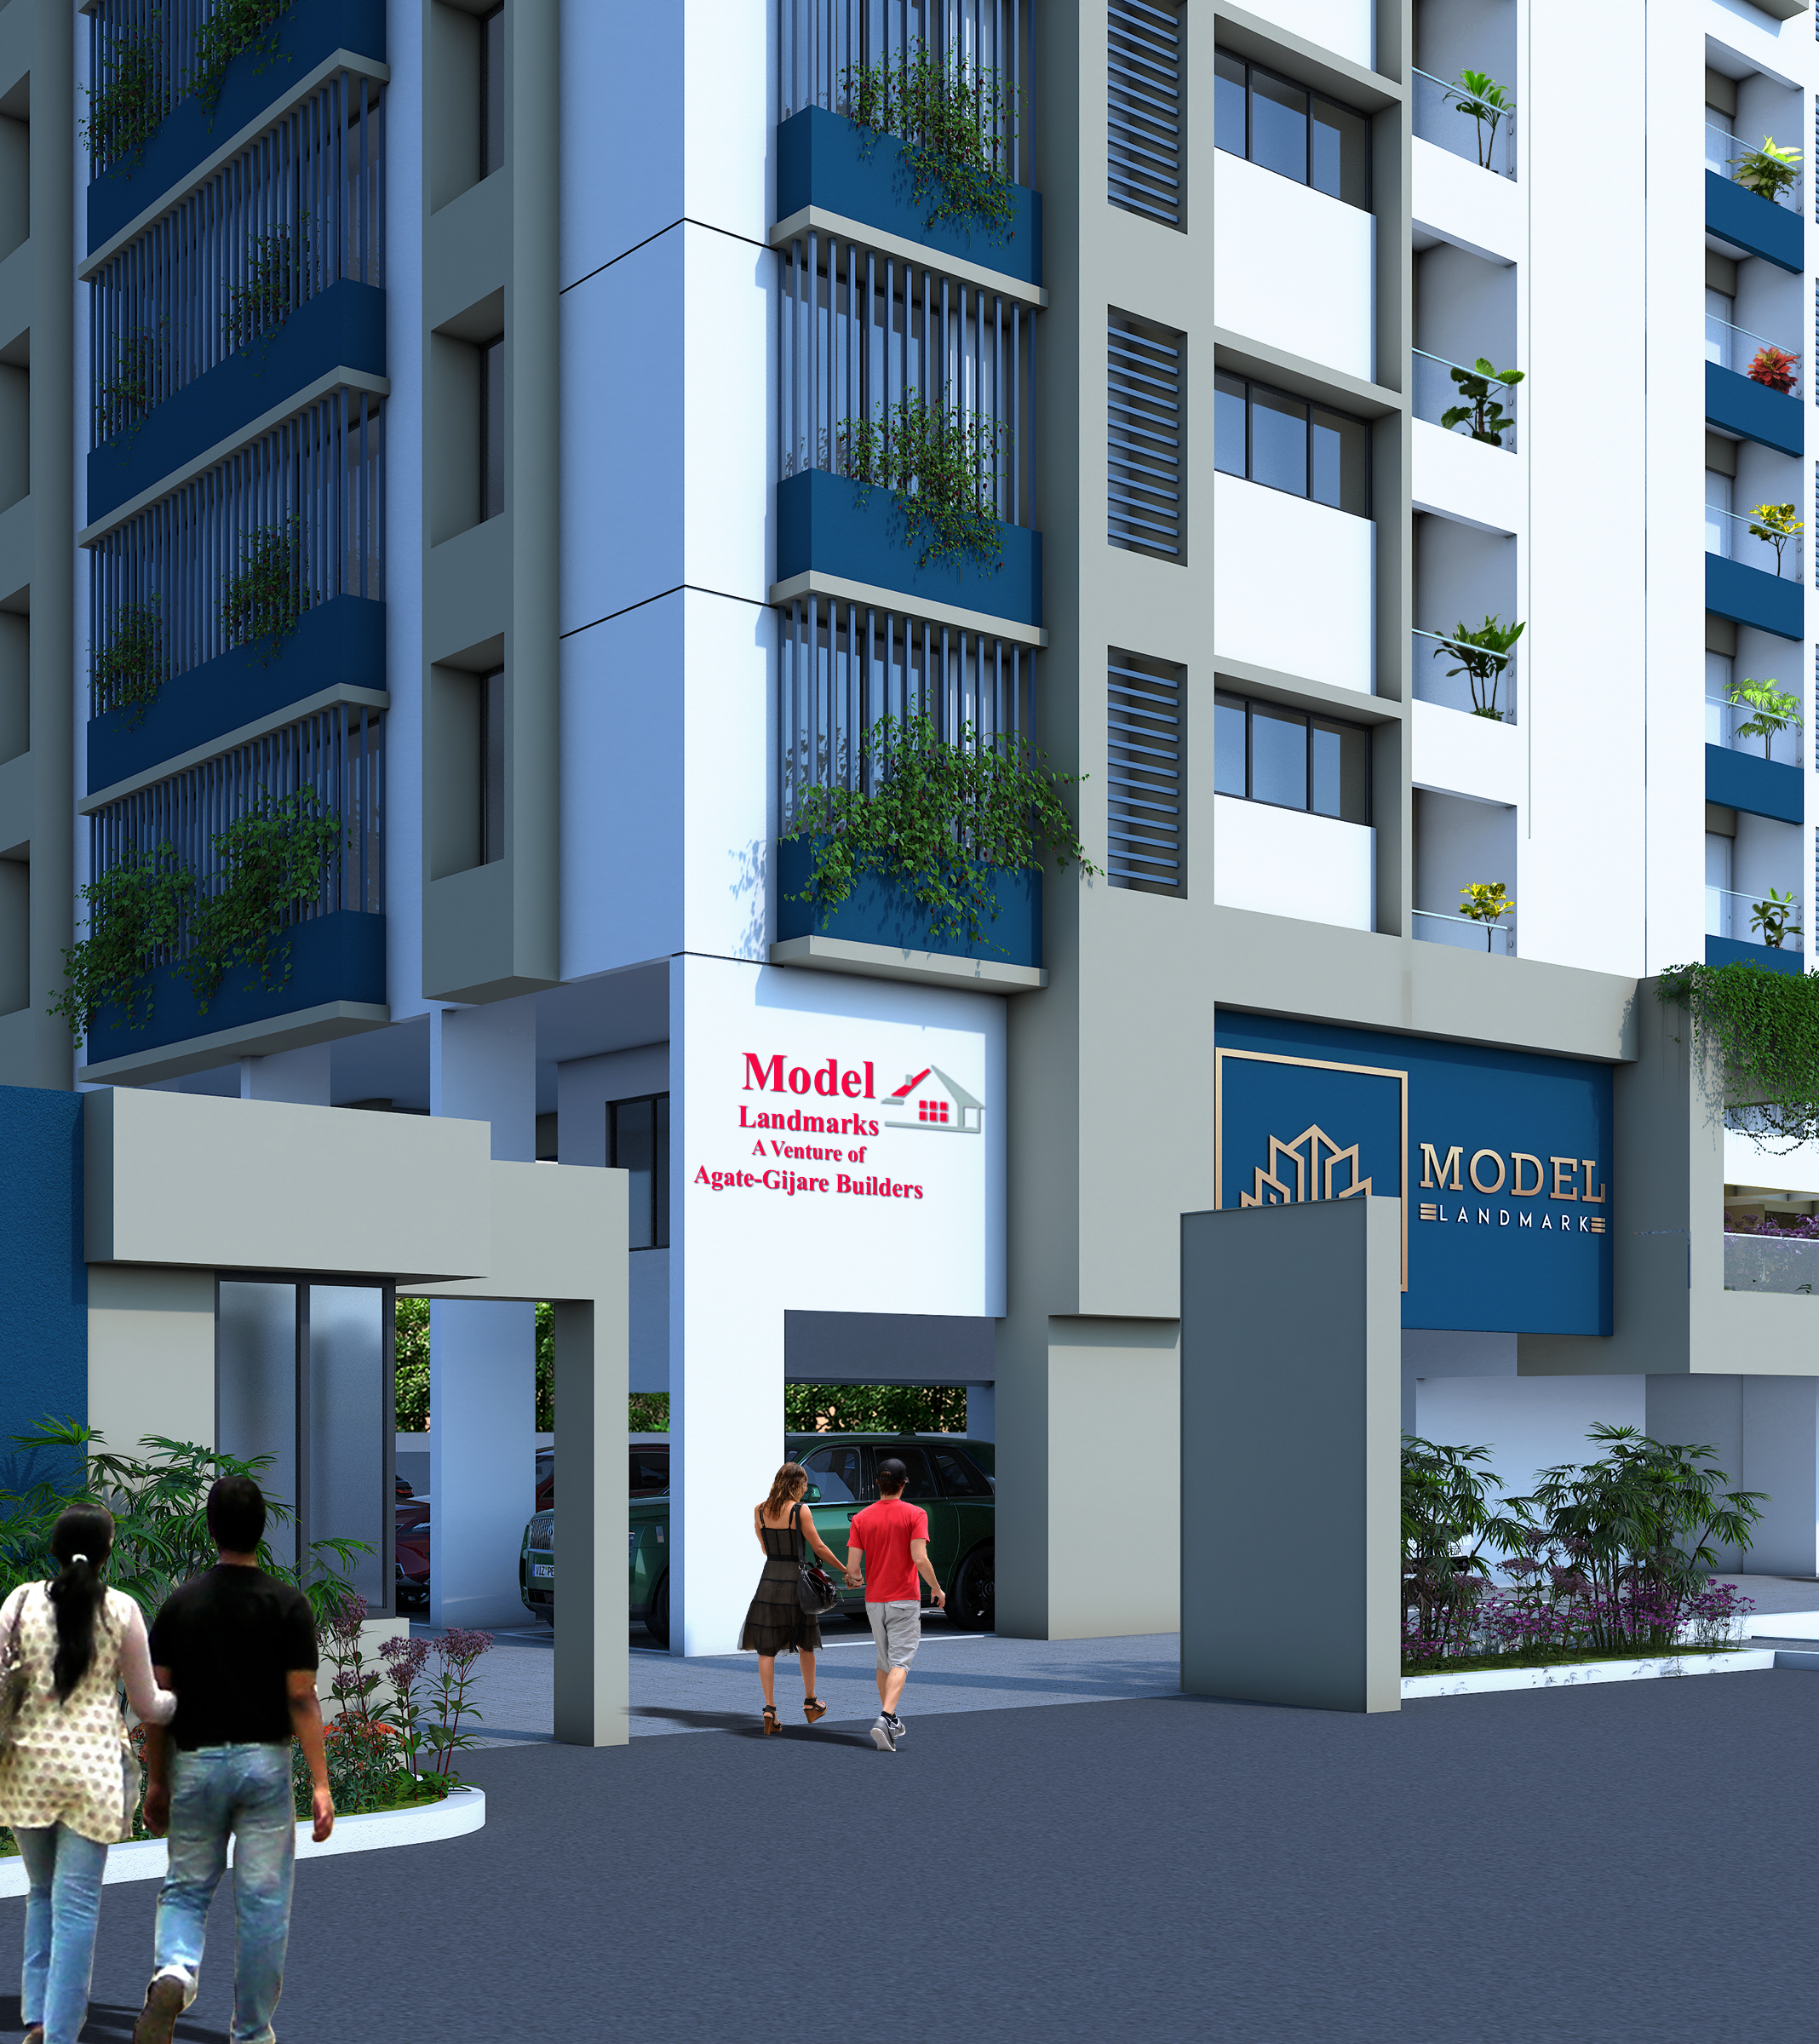

Slide 4
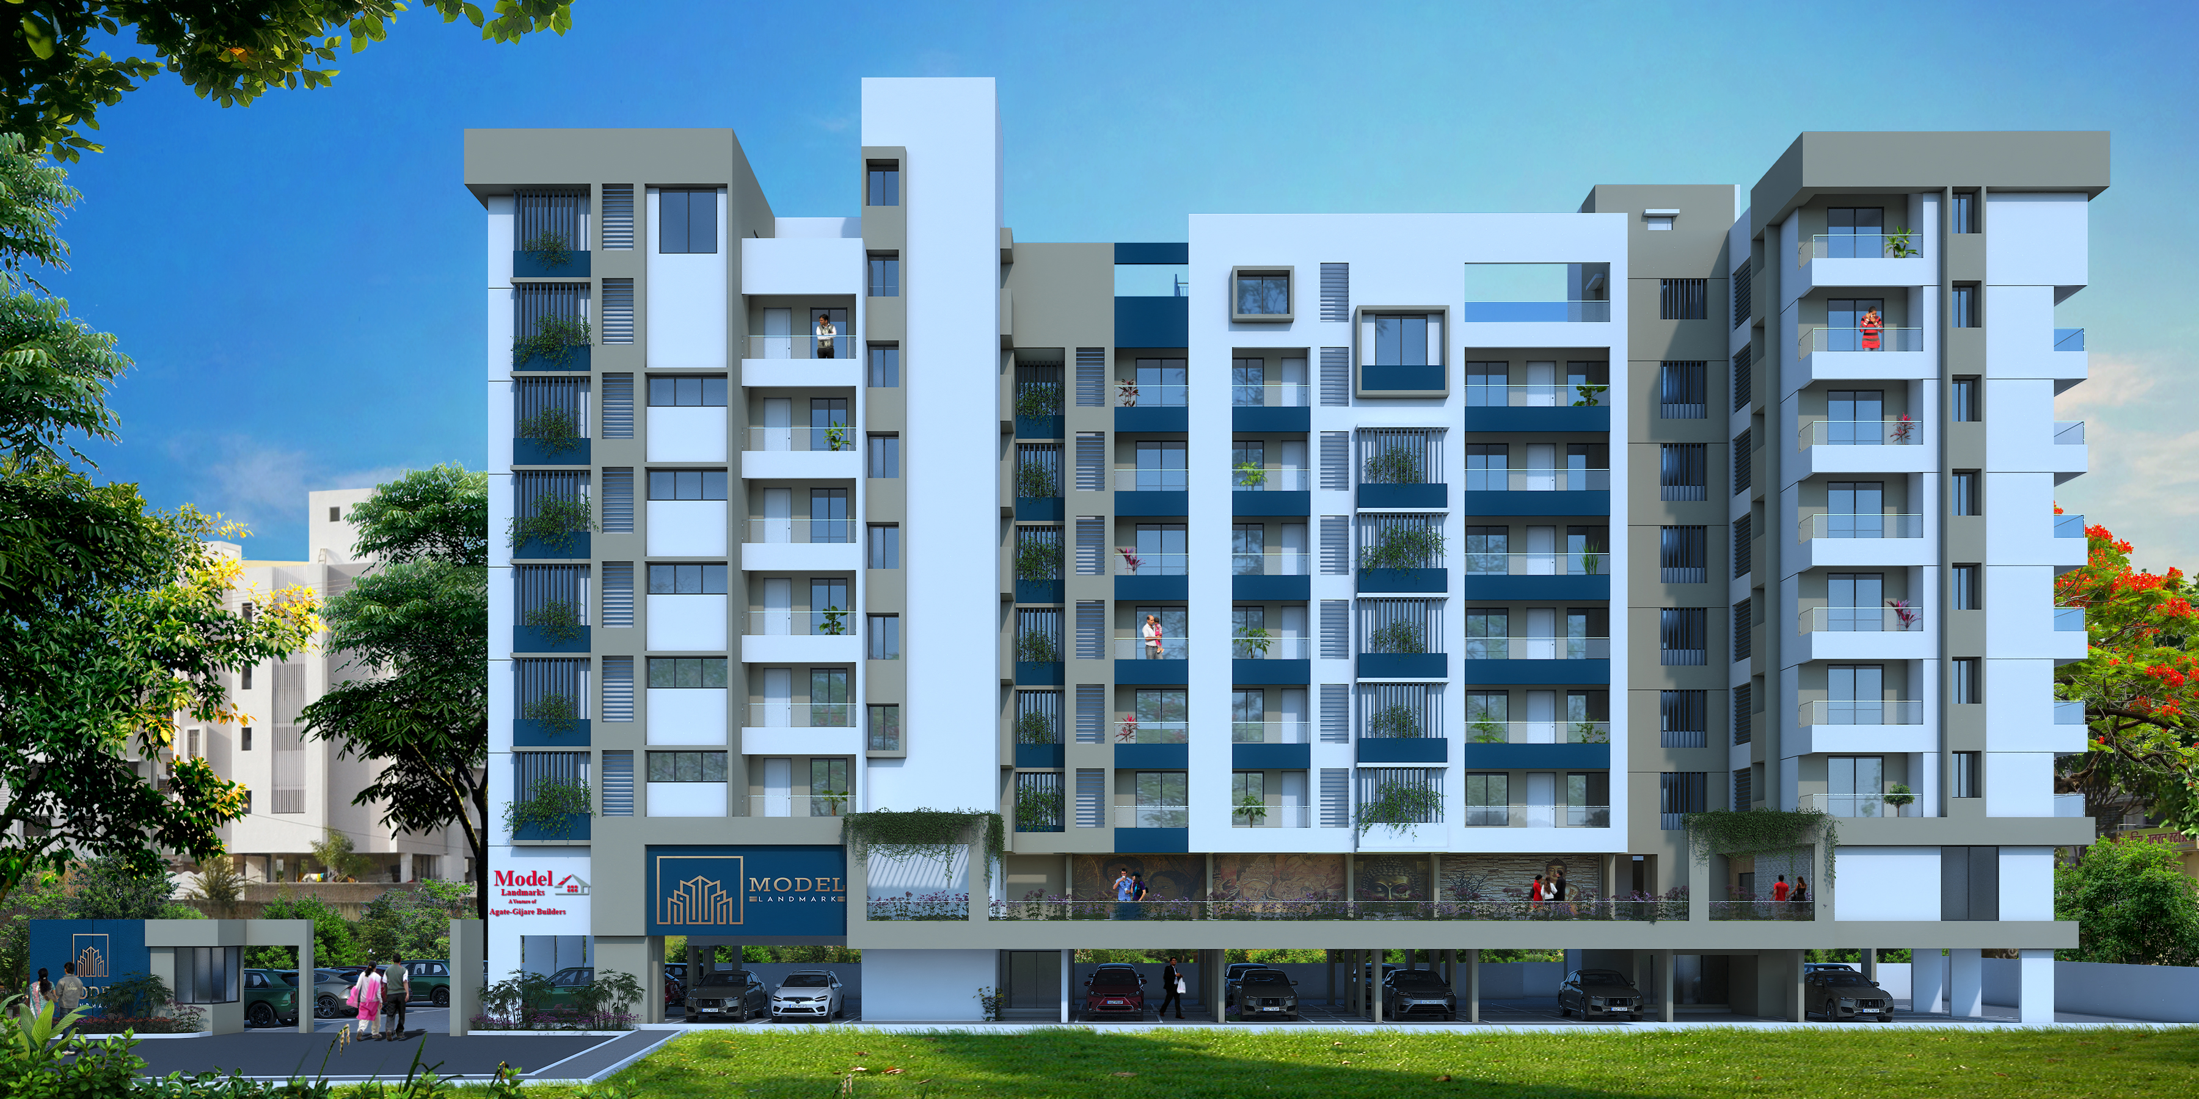

The Landmark Destination of Satara

Slide 5


Slide 6
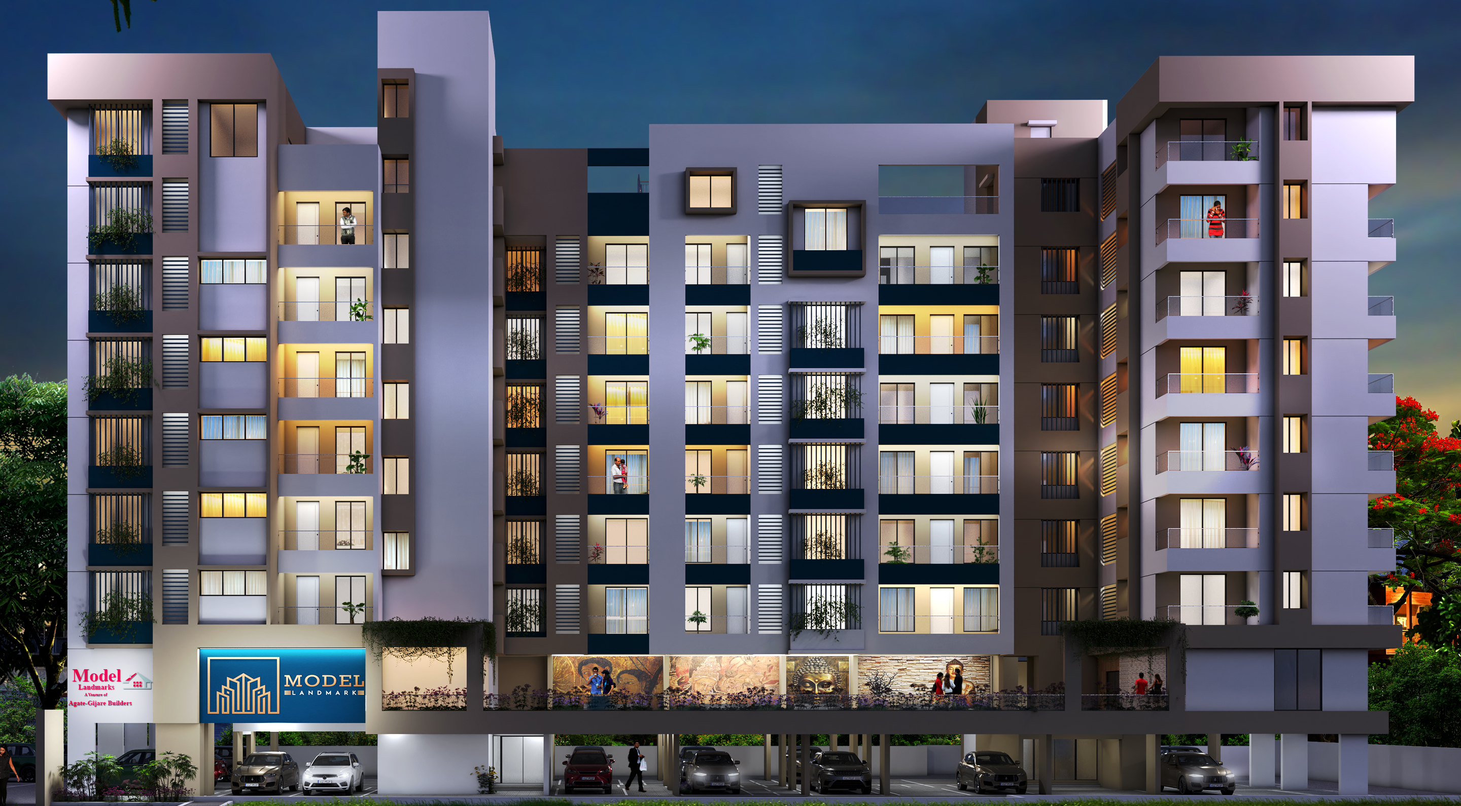
A Master piece of your own @ Powai Naka Satara

Slide 8
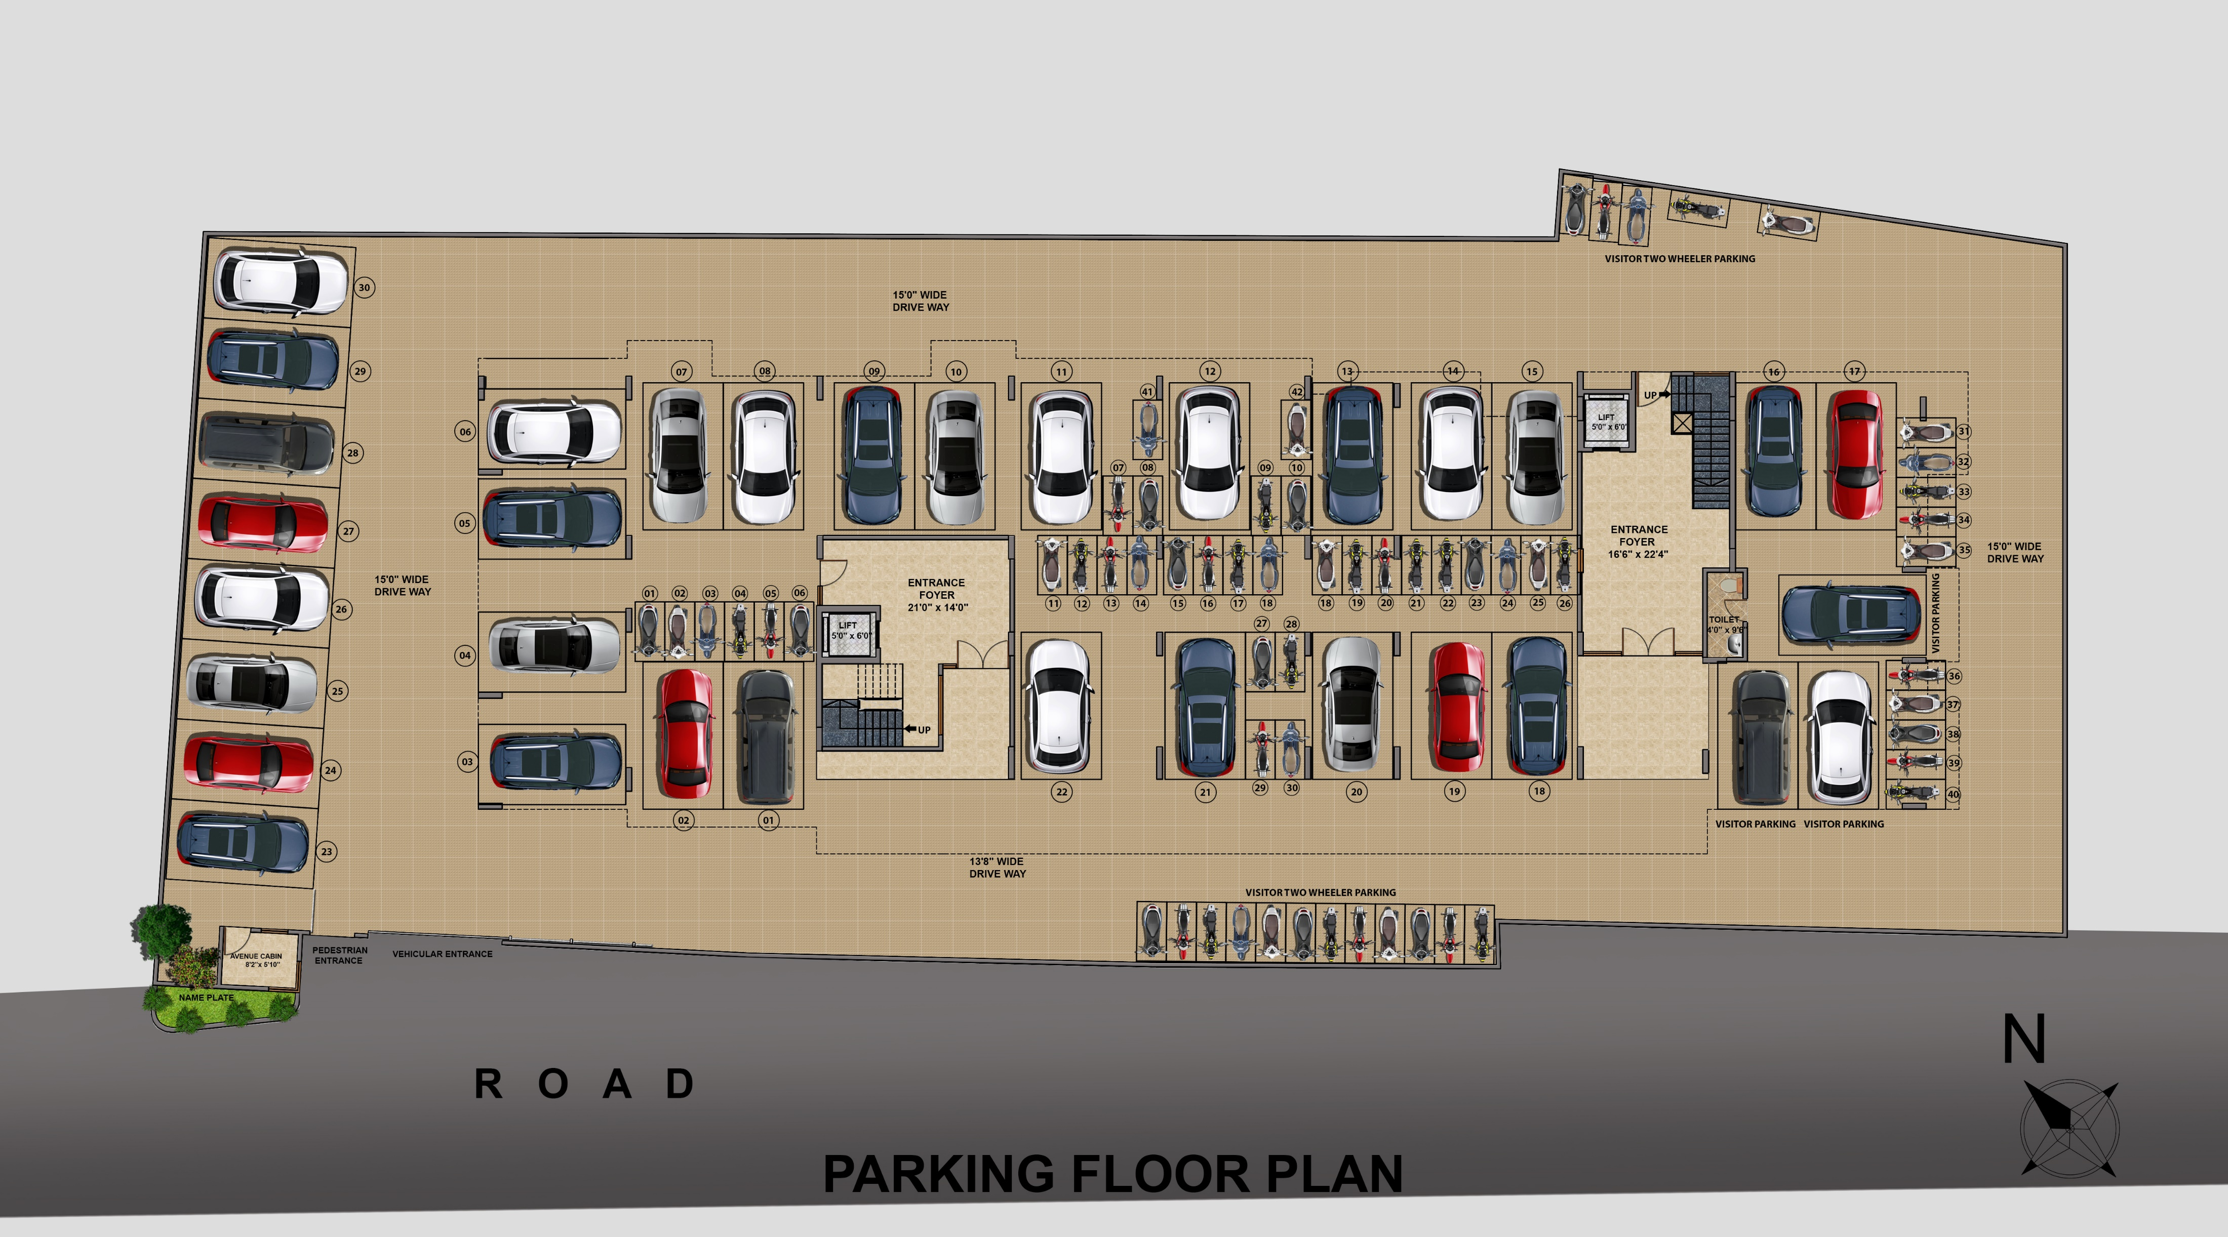


Slide 9
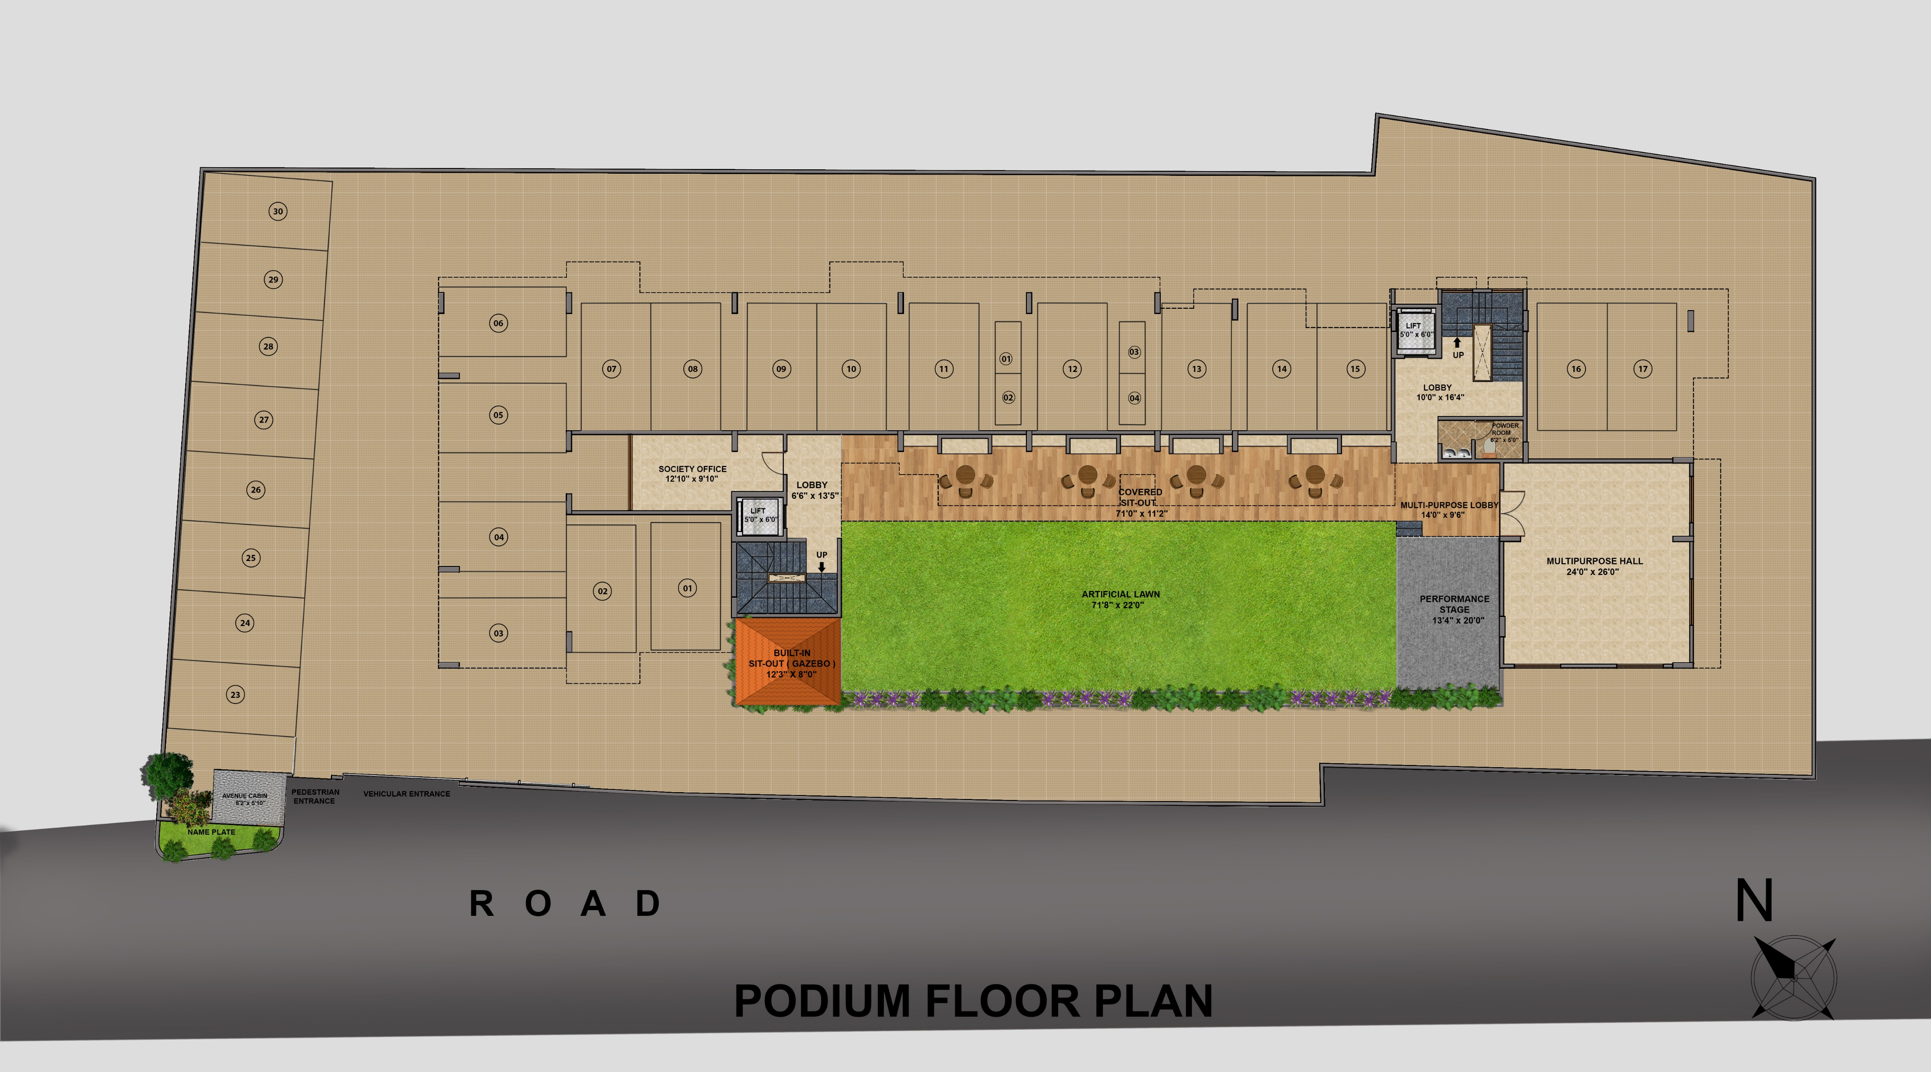


Slide 11
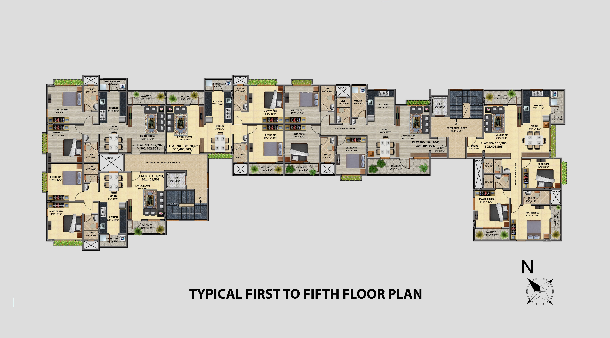

Slide 12
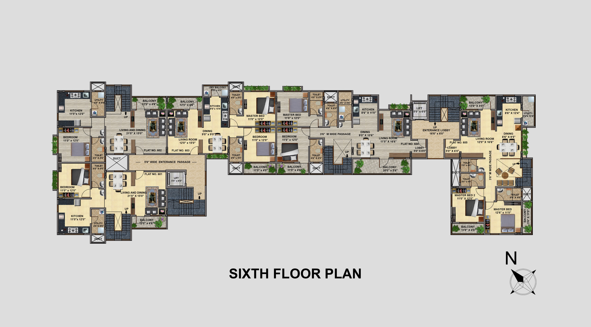

Slide 13
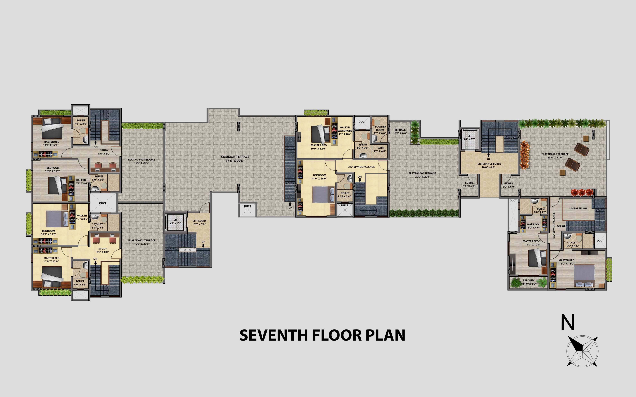

Slide 14

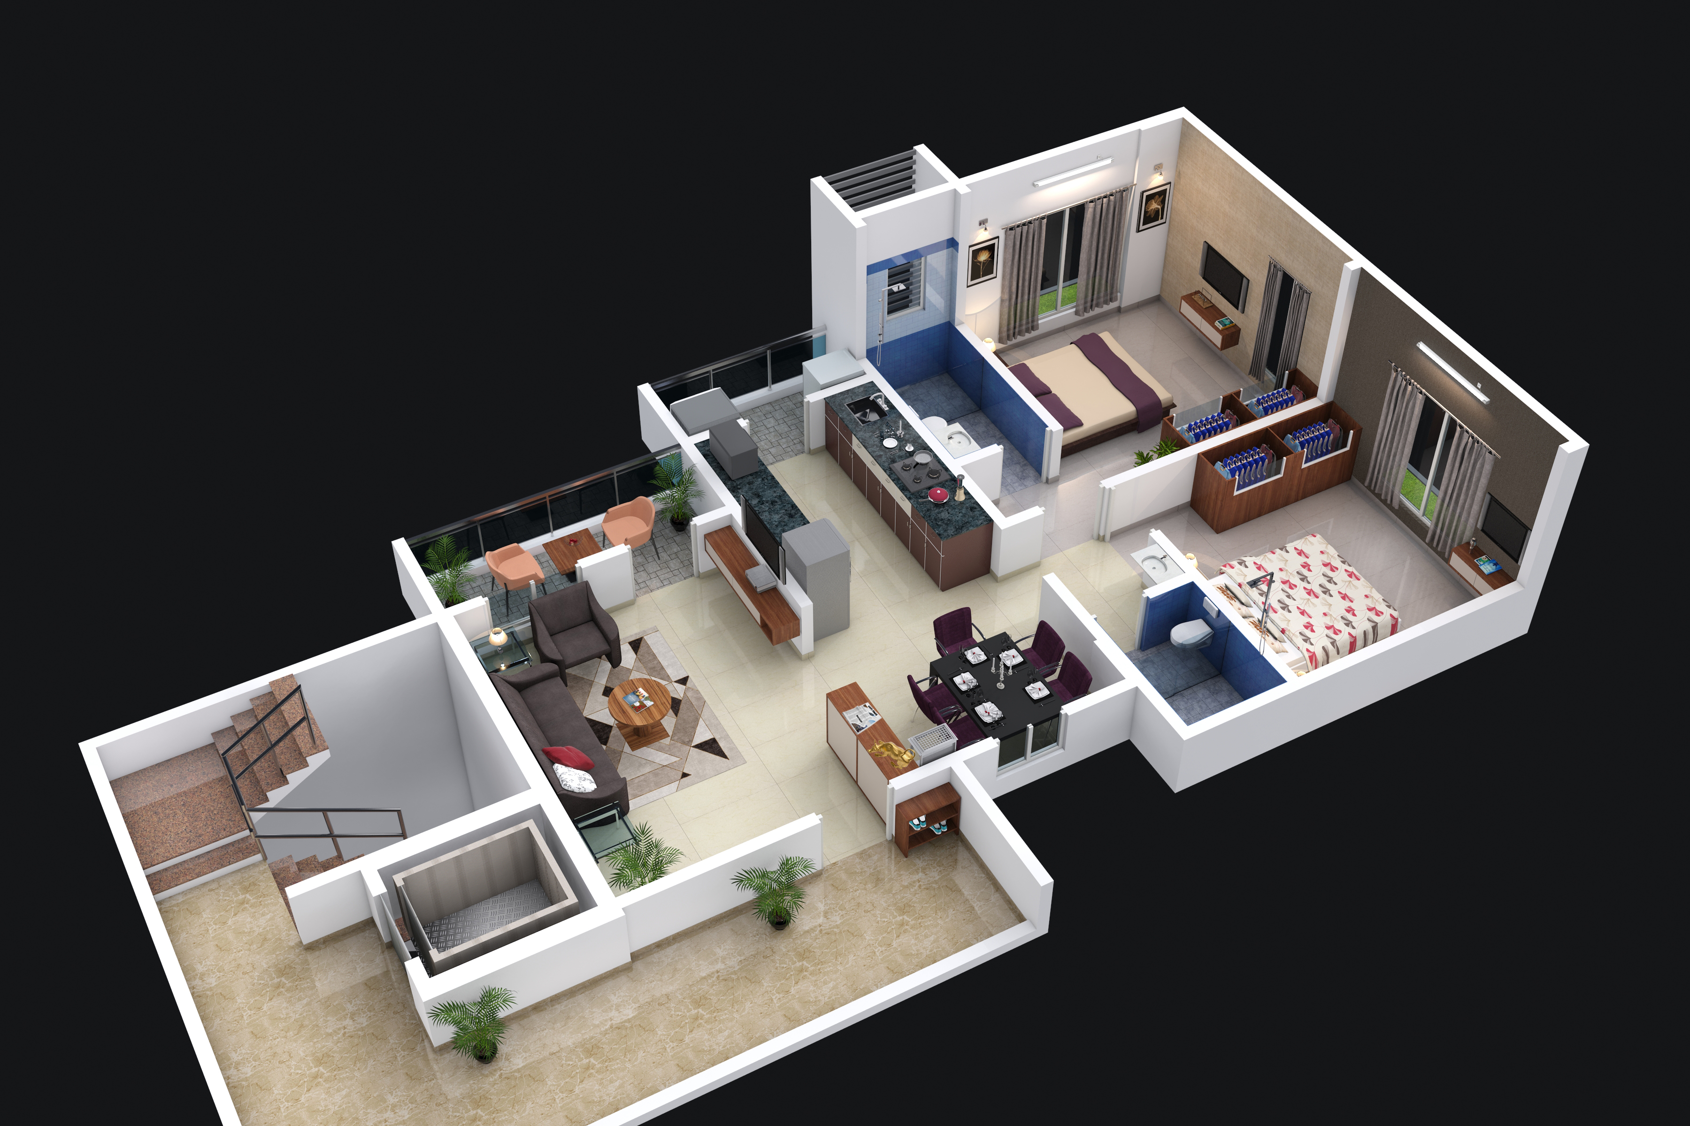
2BHK Type 1

Slide 15
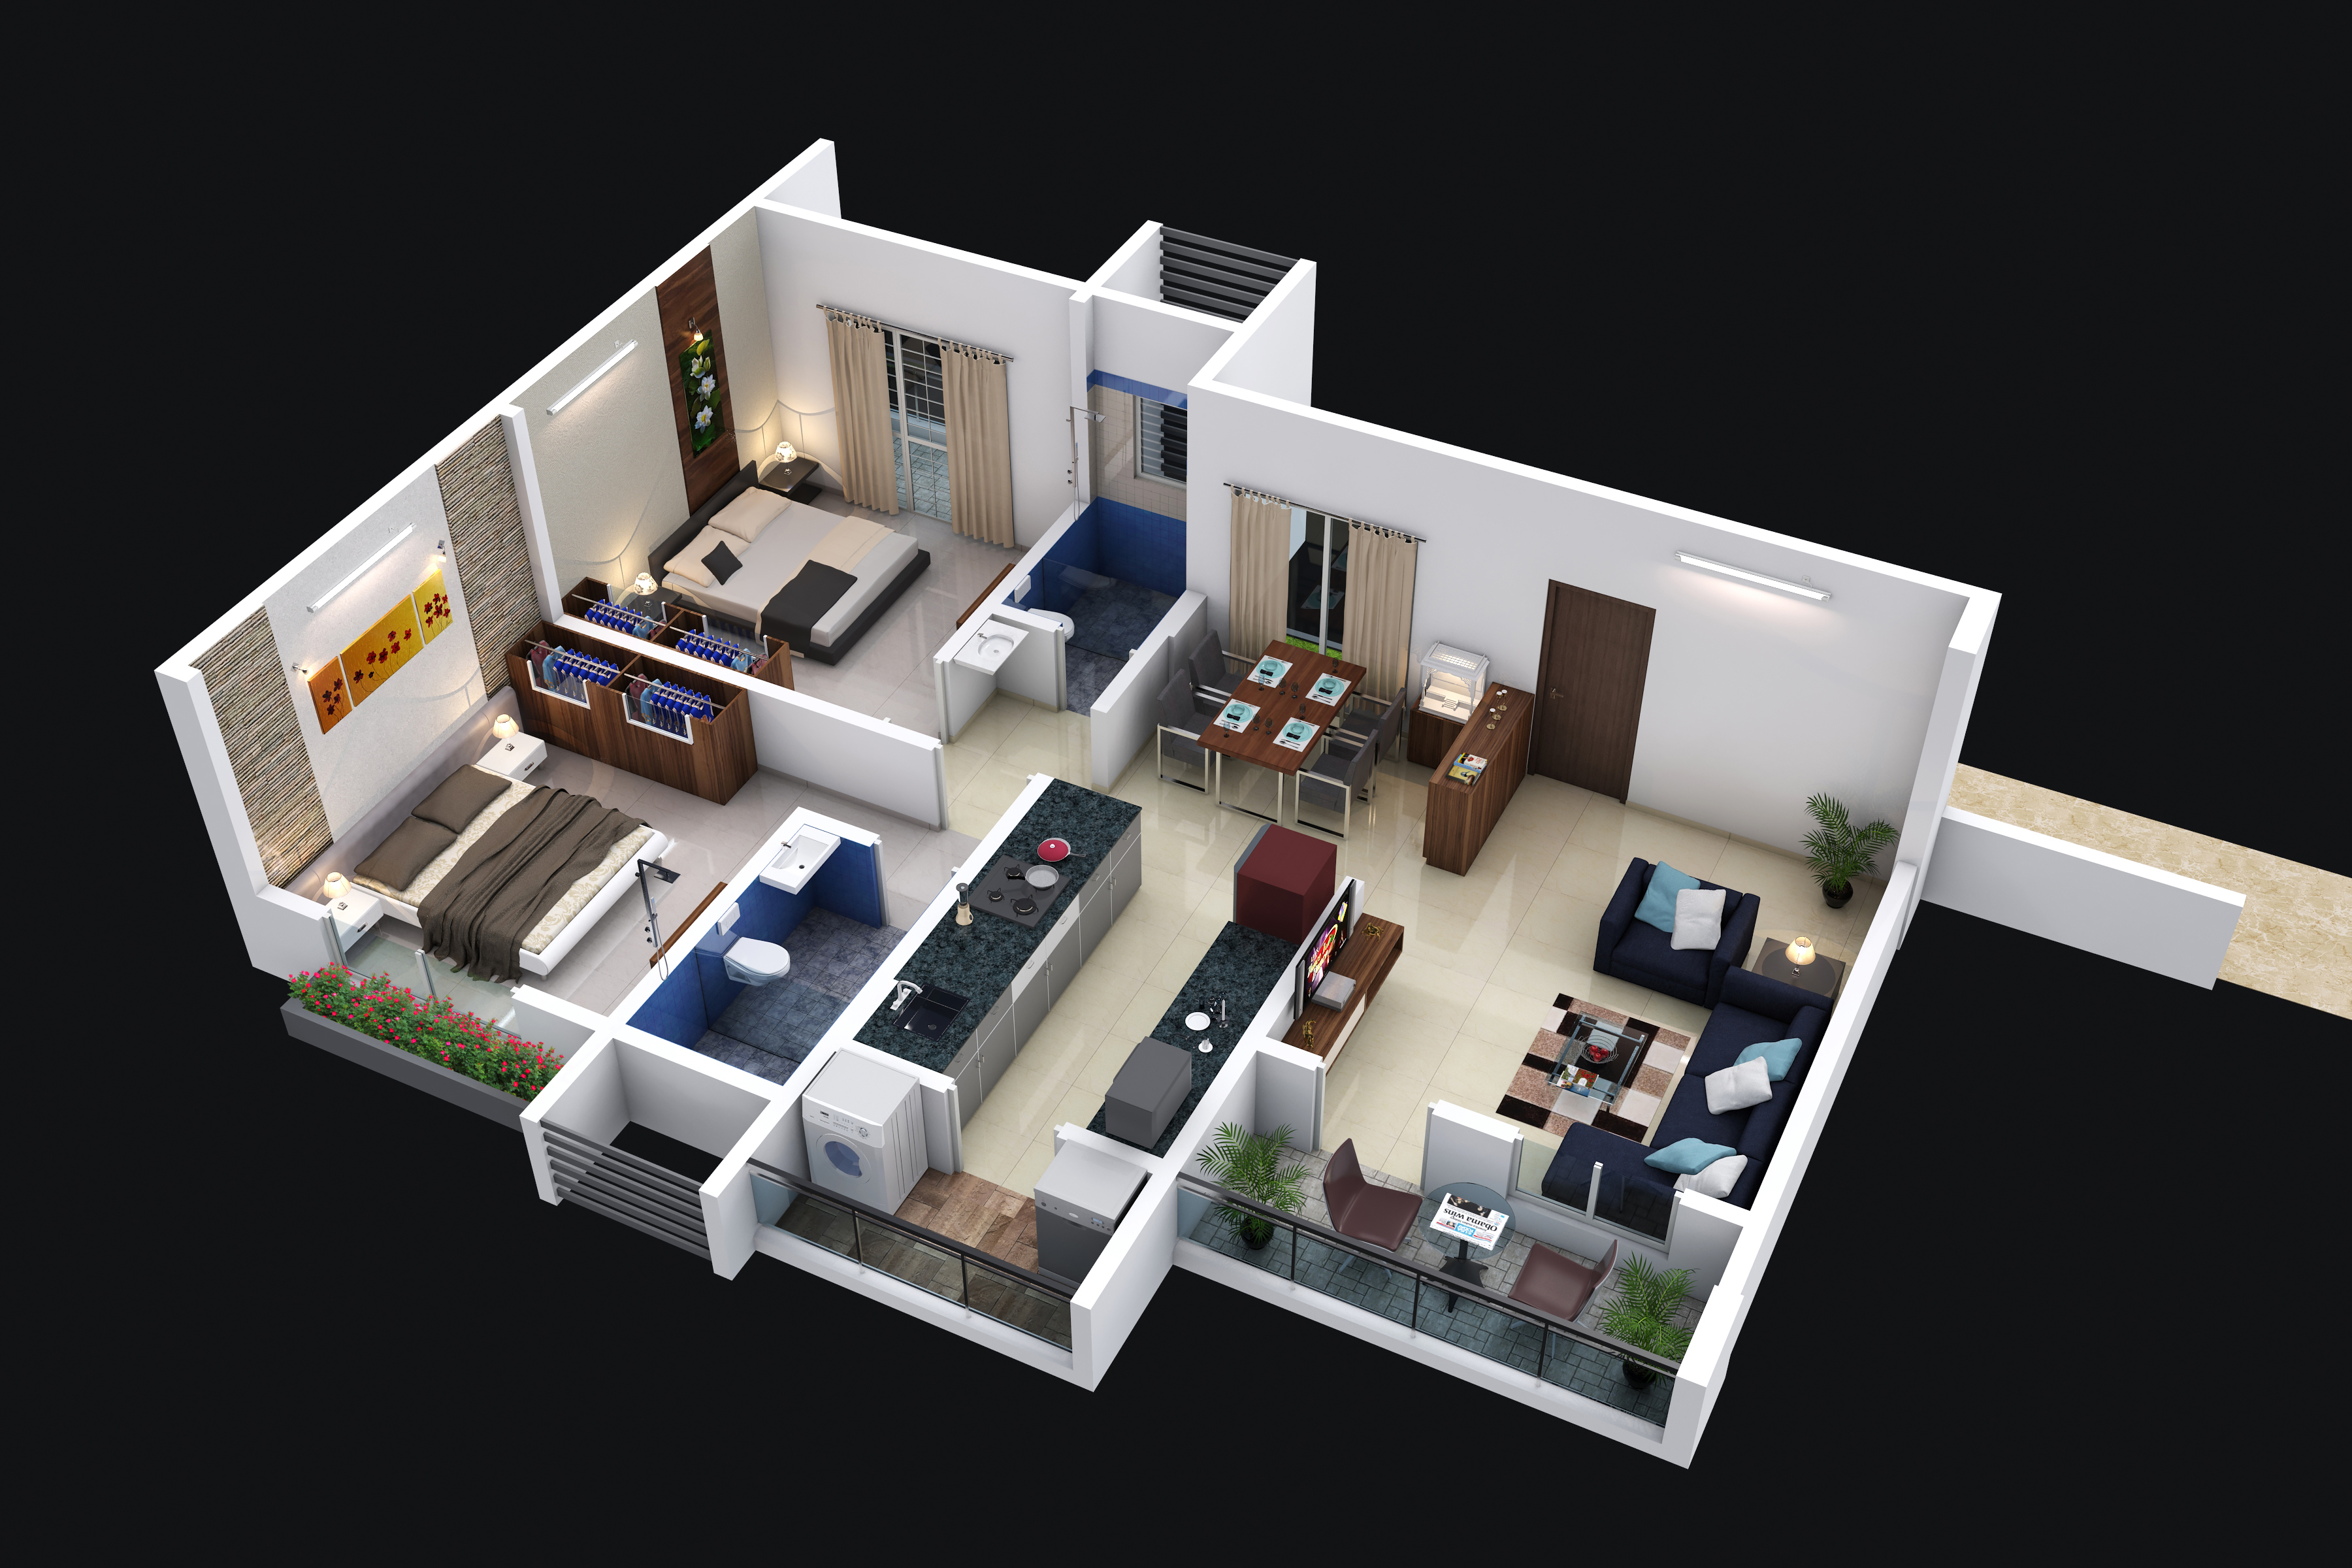
2BHK Type 2

Slide 16
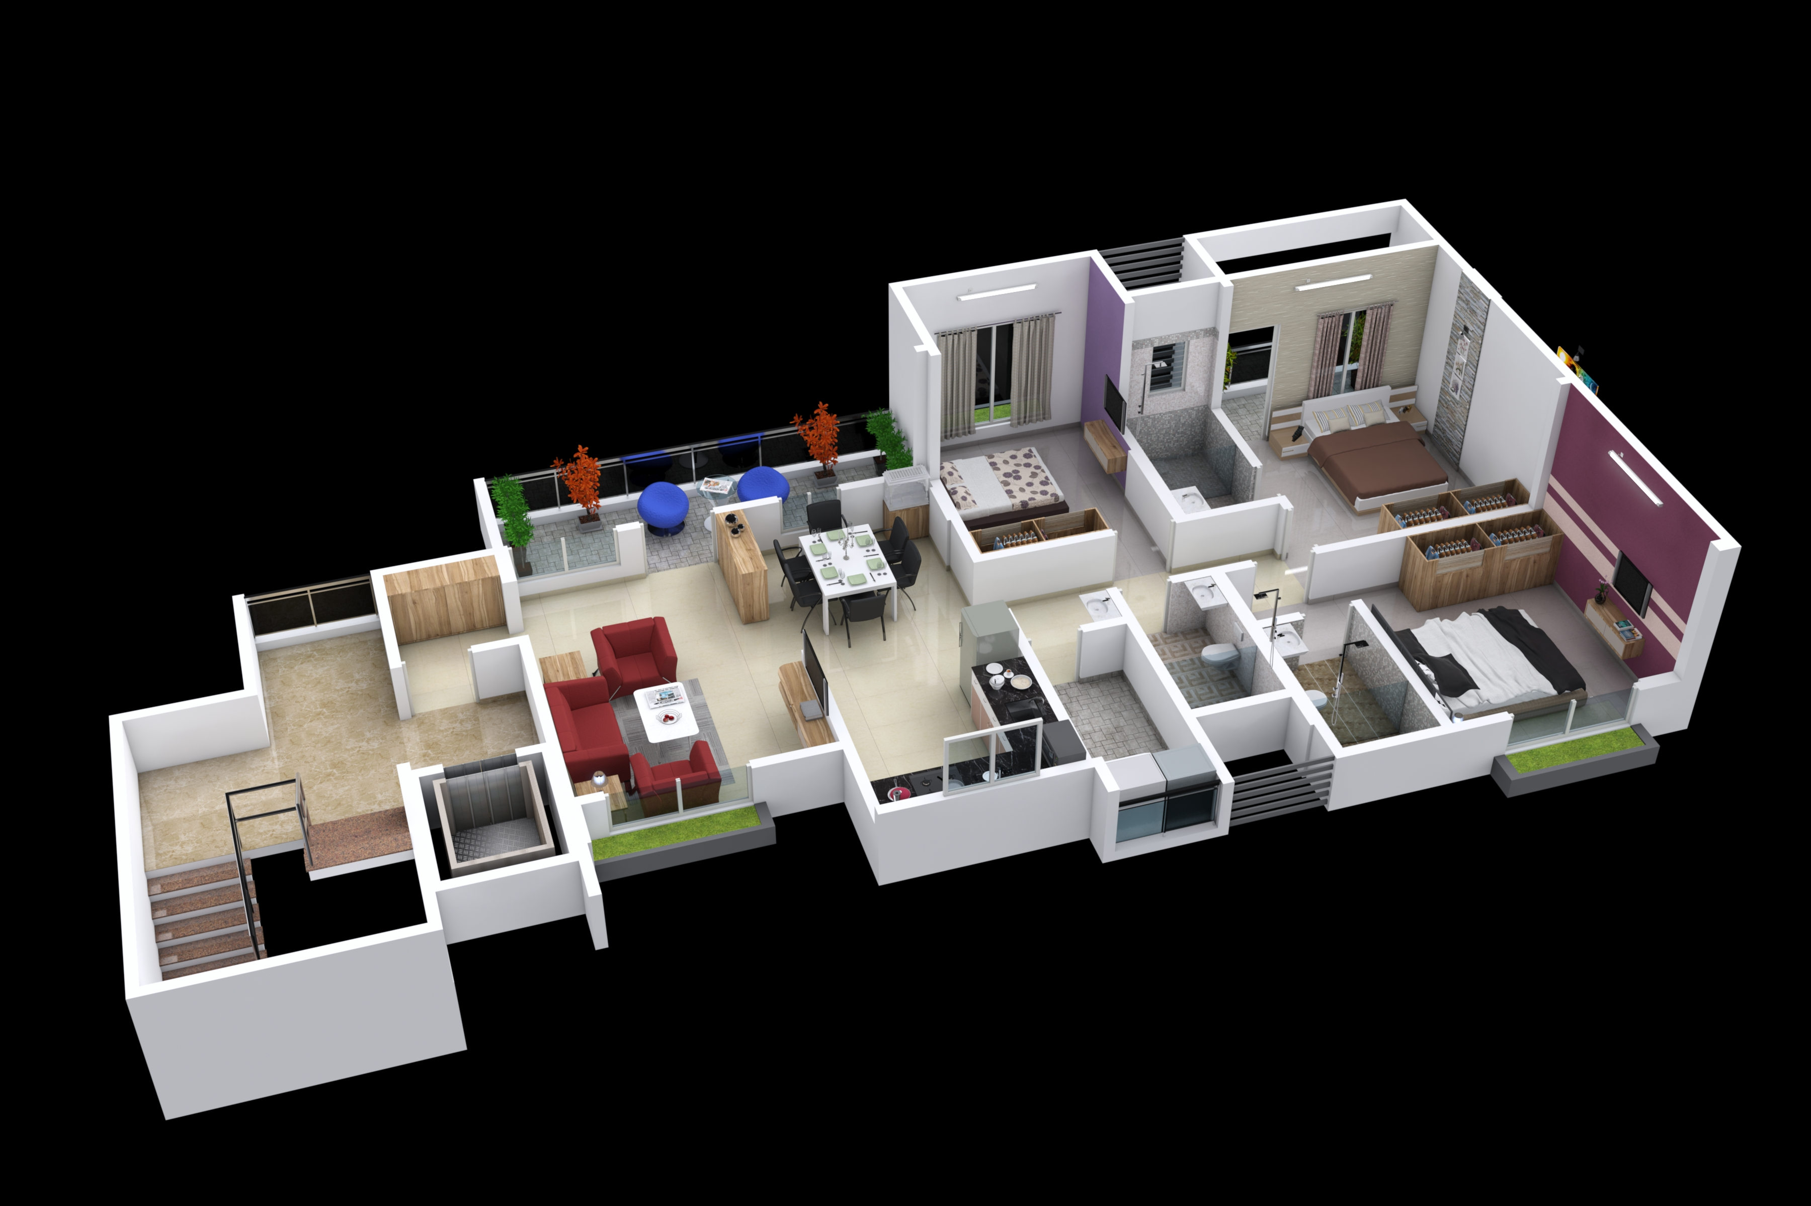

3BHK Type 1

Slide 17
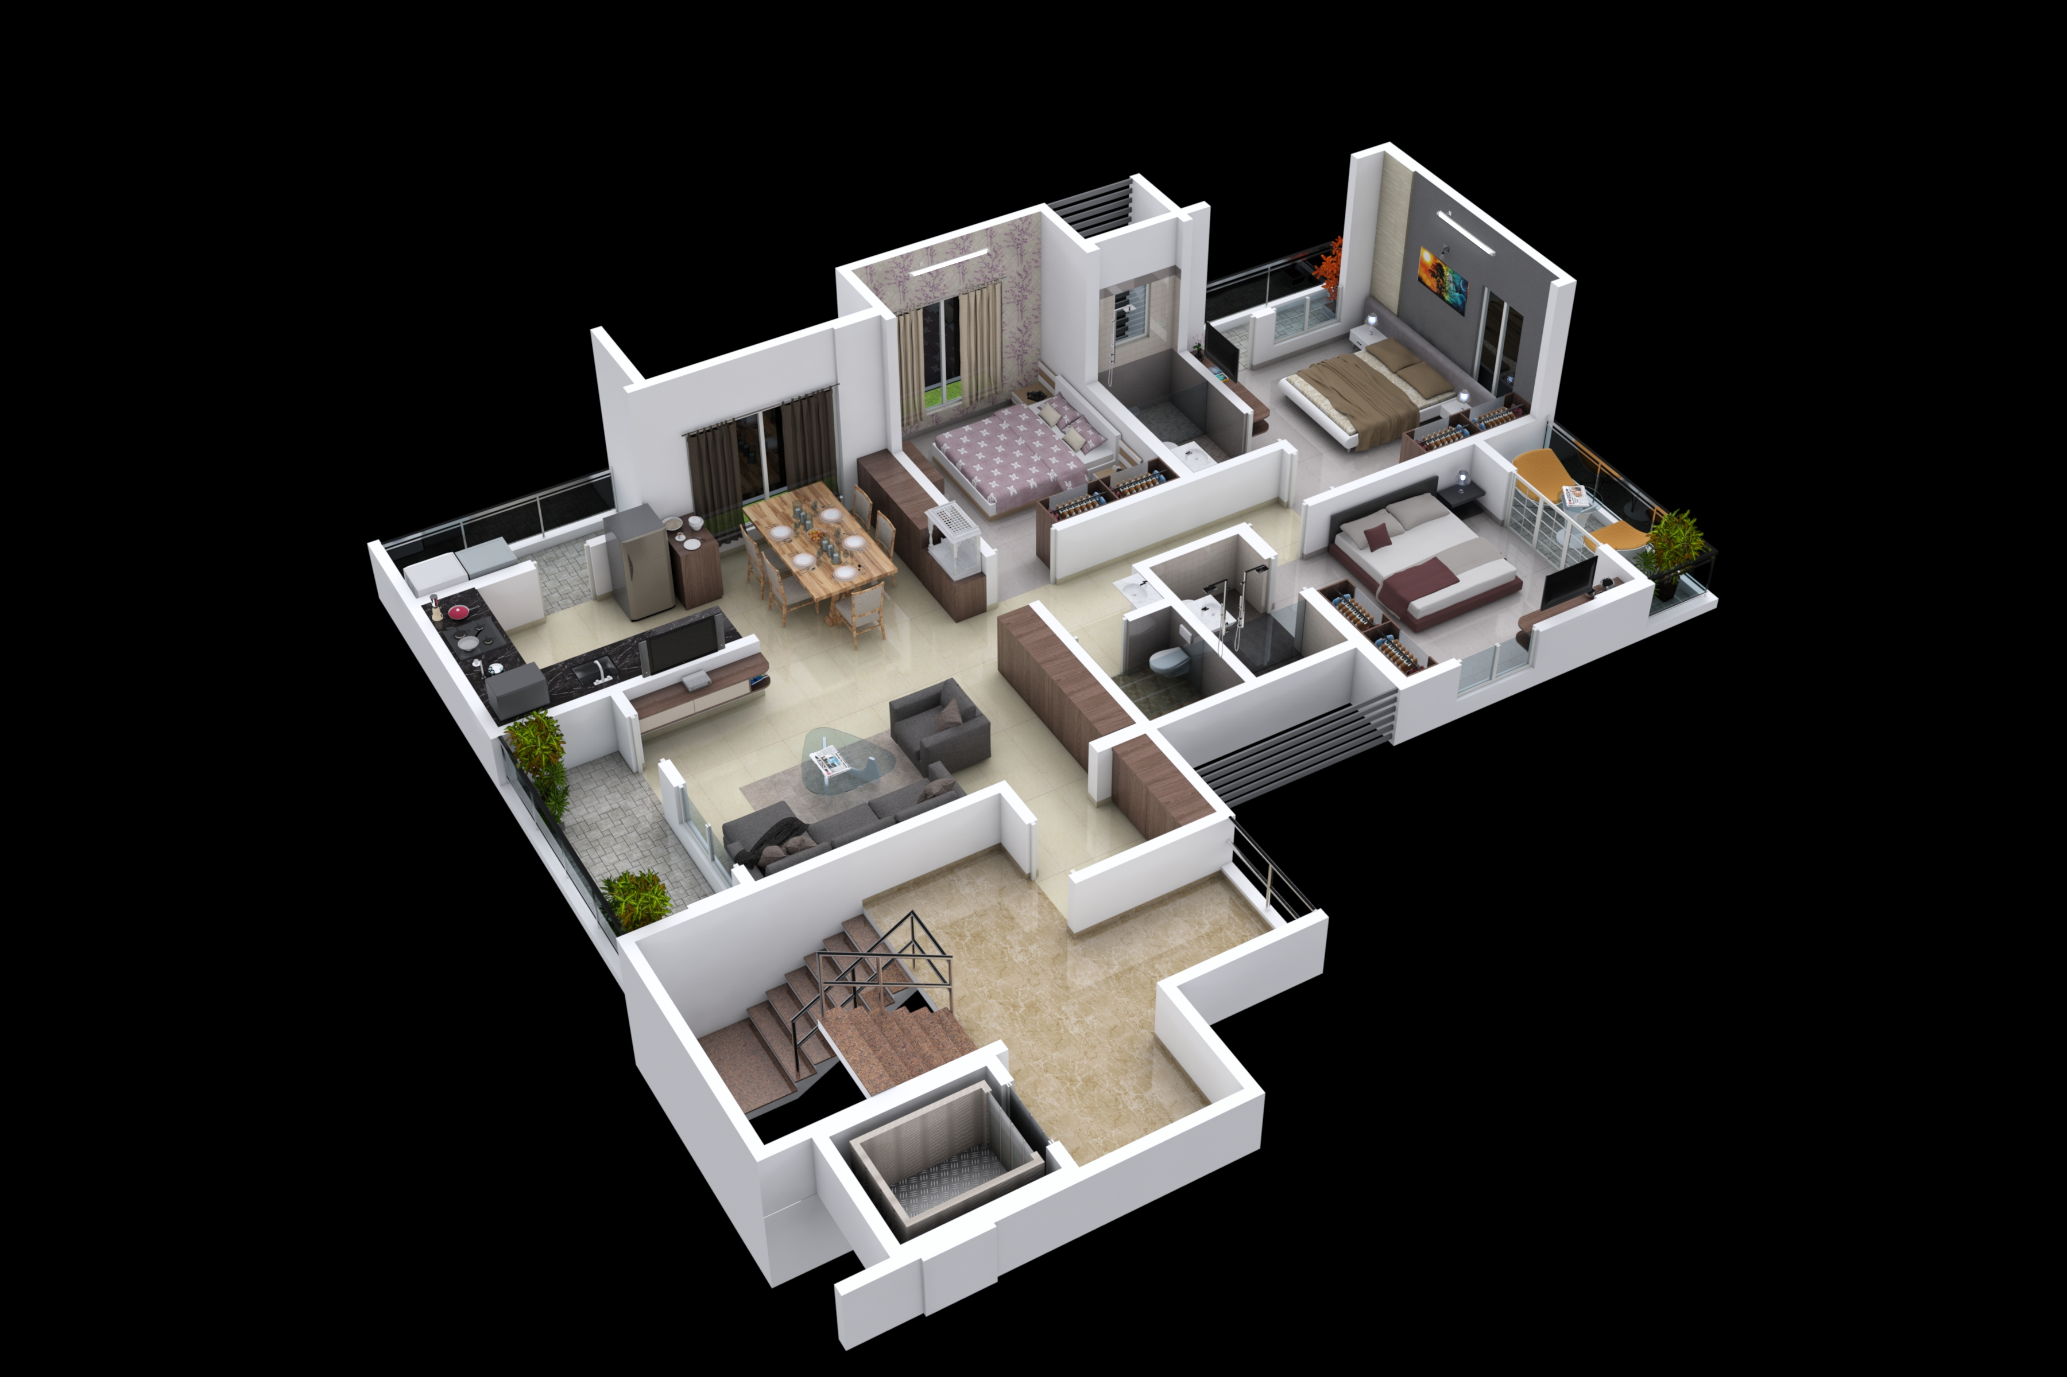
3BHK Type 2

Slide 18
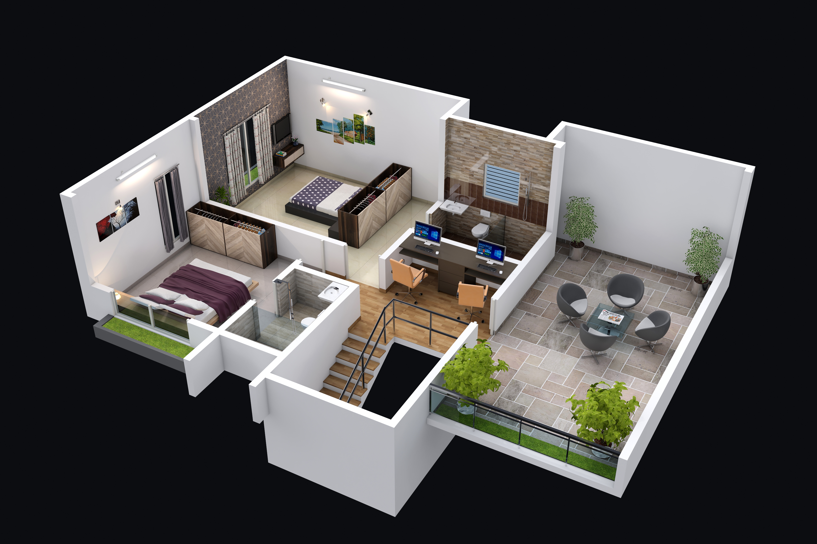
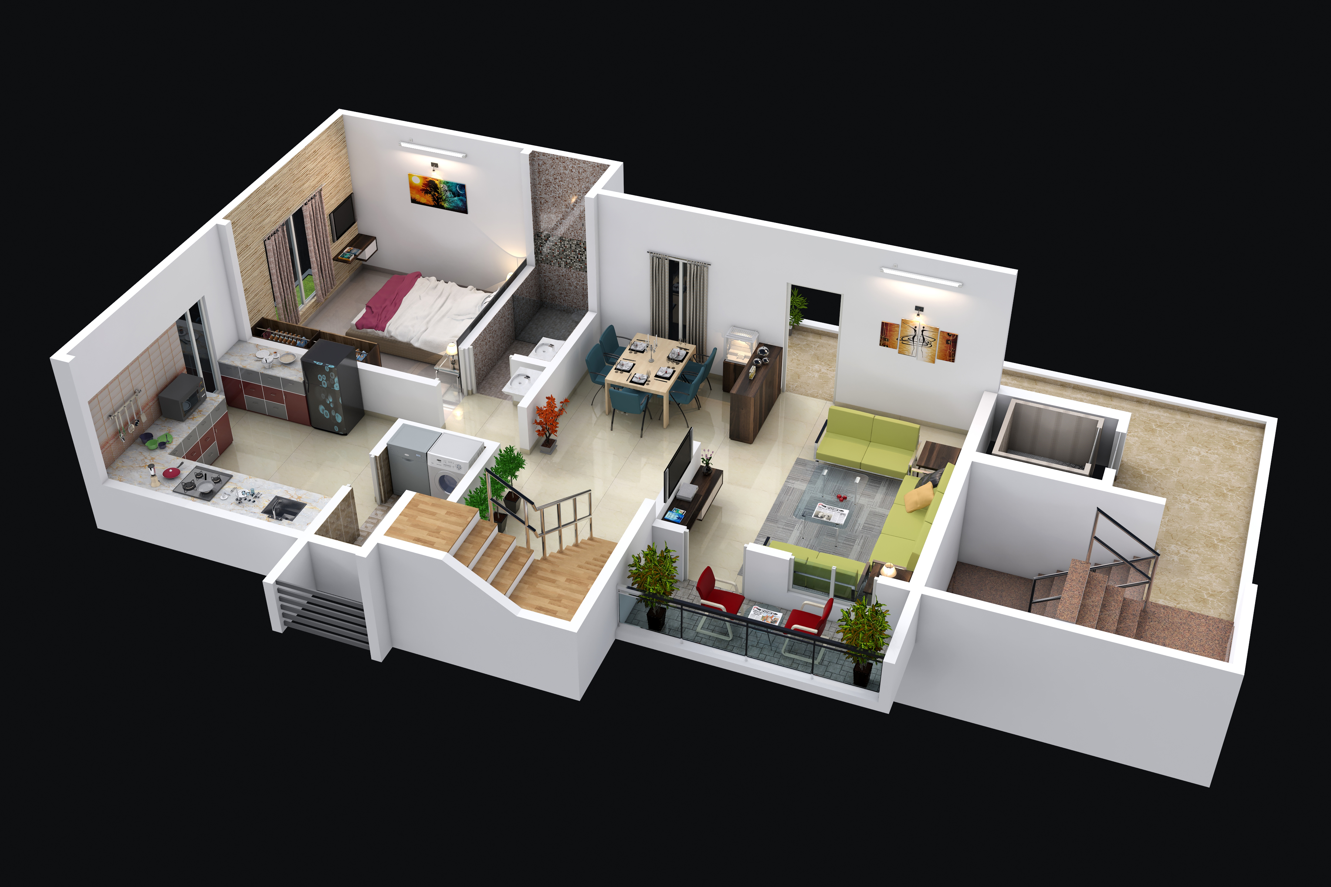
TF
Pent House 3BHK
GF

Slide 20
Project Credentials
ARCHITECT : AR. UPENDRA PANDIT, DESIGN ENCLAVE ARCHITECTS, SATARA
AR. SHREE MAHAJANI, ARCHITECT – INTERIOR – DESIGNER, SATARA.
PMC : SMART PROCESSESS, PUNE..
LEGAL ADVISOR : ADV. RAJENDRA BAHULEKAR, SATARA.
STRUCTURAL CONSULTANT : KULKARNI – BHILARE CONSULTANTS, SATARA.

